Slide 1


Amazon Sales Performance Analysis for Strategic Growth Project Owner: Priya Mankar

Slide 2

Agenda
Introduction
Project Scope
Goal’s and KPI
Visual aids and Analysis
Final tips & takeaways

Slide 3

Problem Description: The provided dataset contains information about sales transactions on Amazon, including details such as order ID, date, status, fulfilment method, sales channel, product category, size, quantity, amount, shipping details, and more. The objective is to conduct a comprehensive analysis of the data and extract actionable insights to support business decision-making.

Slide 4

Project Scope
Analyze Sales Data: Study sales numbers
and trends to understand how the business
is performing overall.
Understand Customer Preferences: Find
out which products and sizes customers like
the most to make better decisions on inventory and marketing.
Explore Regional and Fulfillment Trends:
Look at where most sales come from and
how orders are fulfilled to improve delivery and
customer satisfaction.

Slide 5
Goals And KPI
Goals
Understand Sales Performance: Gain insights into overall sales trends, revenue, and order volume to evaluate business success.
Analyze Customer Behavior: Identify popular products, size preferences, and buying patterns to enhance inventory planning and customer engagement.
Improve Operational Efficiency: Examine fulfillment methods and geographical sales distribution to optimize delivery processes and target high-performing regions.
Key Performance Indicators (KPIs)
Total Sales: $78.59M
Average Sales per Order: $609.34
Total Orders Processed: 128.98K
4. Top Performing State: Maharashtra ($13M in sales)
5. Most Popular Product Category: T-shirts
6. Peak Sales Month: May

Slide 6

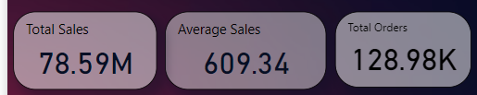
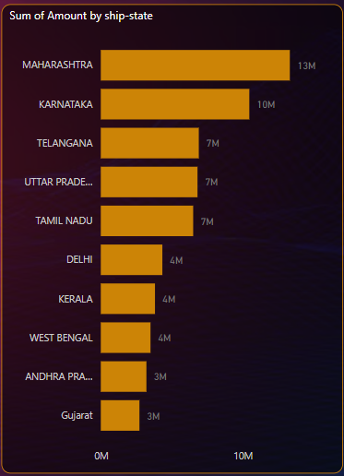
Visual aids and Analysis
Analysis:
Top-performing states:
Maharashtra: $13M
Karnataka: $10M
Telangana, Uttar Pradesh, and Tamil Nadu: $7M each.
Insights:
Maharashtra and Karnataka are key markets, requiring further investment in marketing and logistics.
Analysis:
Total sales amount to $78.59M, indicating strong revenue generation.
Average sales value of $6o9.34 suggests moderate order values per transaction.
128.98 K orders highlight high customer activity.
Insights:
Overall sales performance is strong, with a substantial number of orders driving revenue.

Slide 7
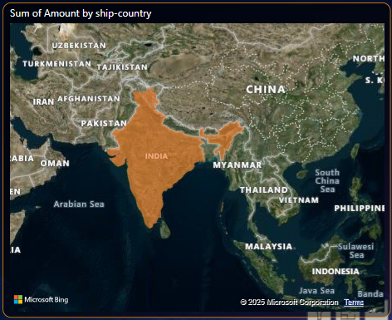
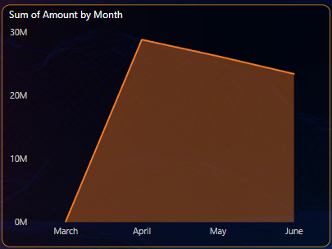
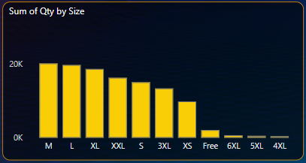
Analysis:
May is the peak sales month, with the highest revenue.
Sales fluctuate across months, with a sharp rise in May.
Insights:
Seasonal or promotional factors might be driving sales in May. Such patterns be leveraged.
Analysis:
India is the primary contributor to sales in this dataset.
Insight:
Focus remains on the Indian market, with potential expansion opportunities internationally.
Analysis:
Most popular sizes: M, L, and XL.
Minimal sales for sizes 6XL, 5XL, and 4XL.
Insight:
Stock should prioritize medium-to-large sizes to match customer demand.

Slide 8
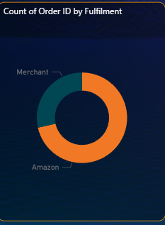
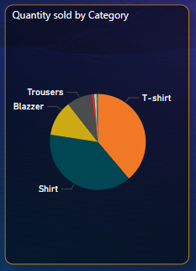
Analysis:
Significant share of orders fulfilled directly by Amazon.
Merchant fulfillment also has a notable contribution.
Insight:
Amazon’s fulfillment processes play a critical role in ensuring customer satisfaction and timely deliveries.
Analysis:
Highest sales in T-shirts, followed by Shirts and Trousers.
Lower sales in categories like Blazers.
Insight: Focus marketing efforts on top-performing categories like T-shirts while exploring ways to boost sales in less popular categories.

Slide 9
Overall Conclusion
Sales Performance: Strong performance with $78.59M in total sales and 128.98K orders. Average sales value is $609.34.
Geographical Insights: Maharashtra and Karnataka lead sales; states like Andhra Pradesh show potential for growth.
Product Preferences: High demand for T-shirts, Shirts, and sizes M, L, XL.
Sales Trends: Peak sales in May suggest focusing promotions during this time.
Fulfillment: Amazon dominates fulfillment; room for improvement in merchant efficiency.

Slide 10
Final tips & takeaways
Prioritize top regions like Maharashtra and Karnataka.
Promote best-sellers like T-shirts and Shirts.
Leverage peak months (e.g., May) for offers.
Address fulfillment gaps for faster delivery.
Personalize strategies using customer insights.
Expand in low-performing regions.
Stock high-demand products.
Build customer loyalty programs.
Use data regularly for better decisions.

Slide 11

Thank you!!
Priya Mankar
mankarpriya45@gmail.com

